Slide 1

Hotel Reservation Analysis by Kandra Aashritha

Slide 2
Project Description
Data is essential to the industry’s ability to make decisions and deliver a better guest experience.
In this project, I have worked with a hotel reservation dataset to gain insights into guest preferences, booking trends, and other key factors that impact the hotel's operations.
In addition to querying and analyzing the data, I have utilized SQL to respond to specific queries regarding the dataset.

Slide 3
Approach
First I have checked the given dataset using MS Excel to ensure that the given data is clean enough to proceed further.
Then I have created a new Schema named “hotel” MySQL.
Next I have imported the given dataset in the form of a csv file into the MySQL Workbench using Table Data Import Wizard and started querying to draw necessary insights from the hotel reservation dataset.

Slide 4
Tech-Stack Used
MY SQL
MySQL Workbench 8.0 CE

Slide 5
The dataset includes the following columns:
Booking_ID: A unique identifier for each hotel reservation.
no_of_adults: The number of adults in the reservation.
no_of_children: The number of children in the reservation.
no_of_weekend_nights: The number of nights in the reservation that fall on weekends.
no_of_week_nights: The number of nights in the reservation that fall on weekdays.
type_of_meal_plan: The meal plan chosen by the guests.
room_type_reserved: The type of room reserved by the guests.
lead_time: The number of days between booking and arrival.
arrival_date: The date of arrival.
market_segment_type: The market segment to which the reservation belongs.
avg_price_per_room: The average price per room in the reservation.
booking_status: The status of the booking.

Slide 6
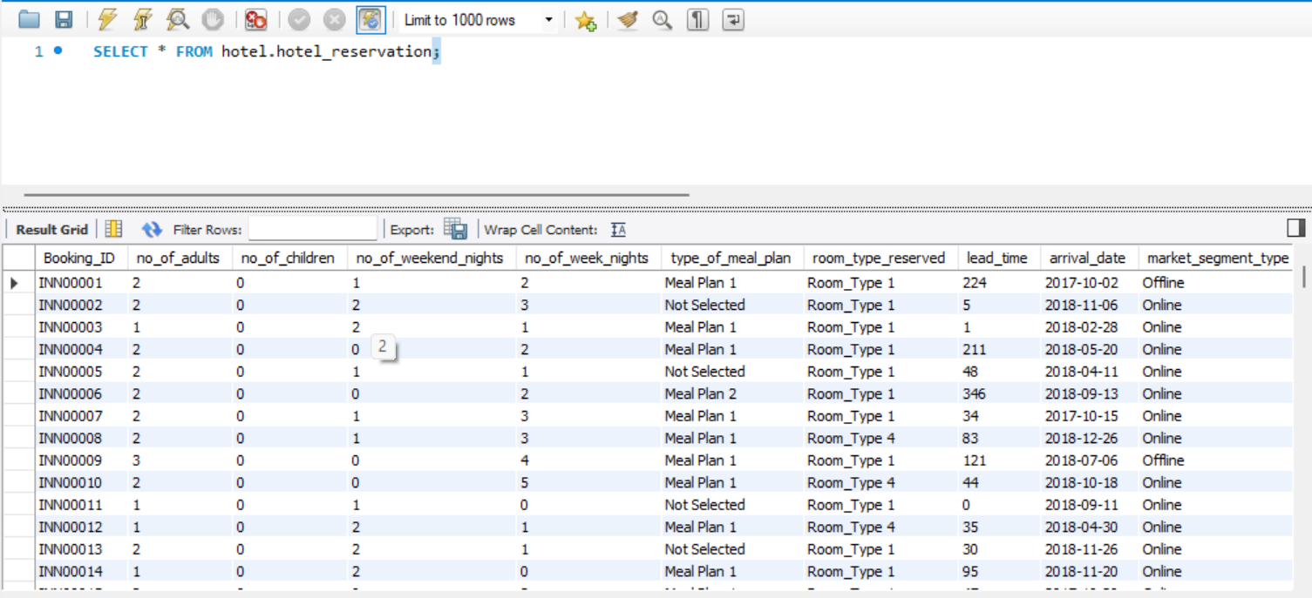
Overview of dataset

Slide 7
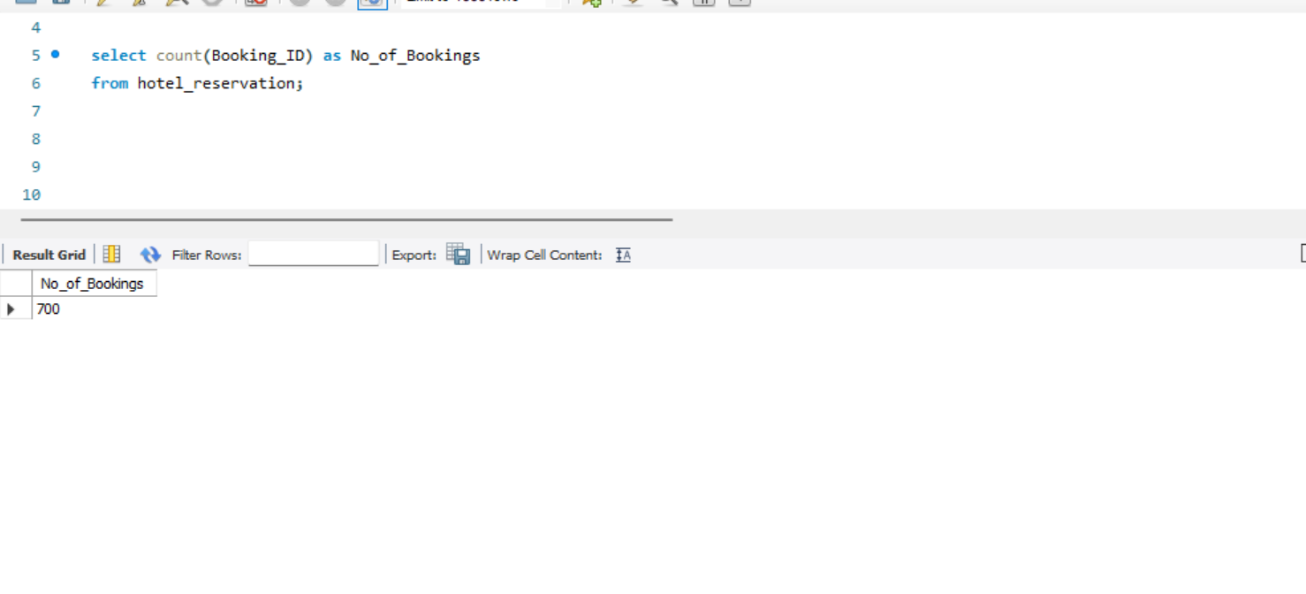
Questions:
What is the total number of reservations in the dataset?

Slide 8
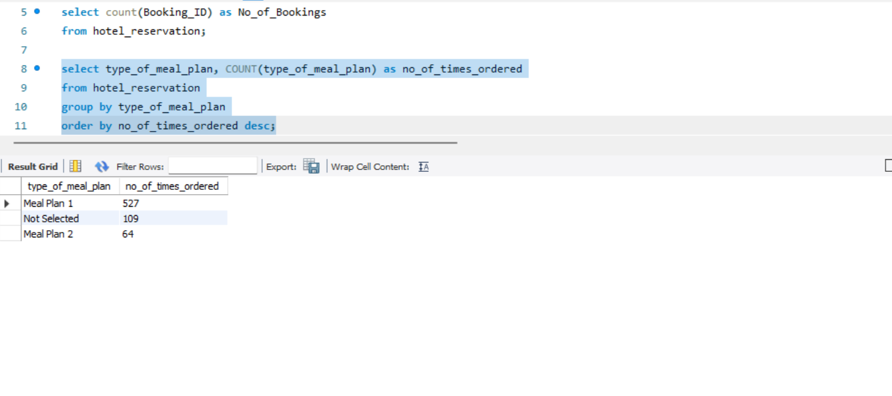
2. Which meal plan is the most popular among guests?

Slide 9
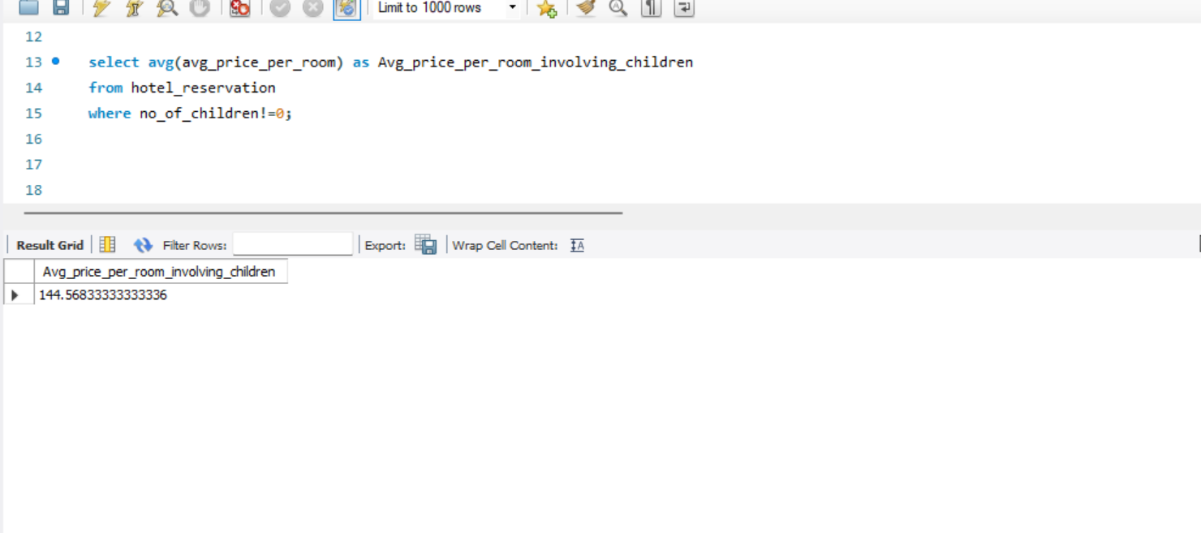
3. What is the average price per room for reservations involving children?

Slide 10
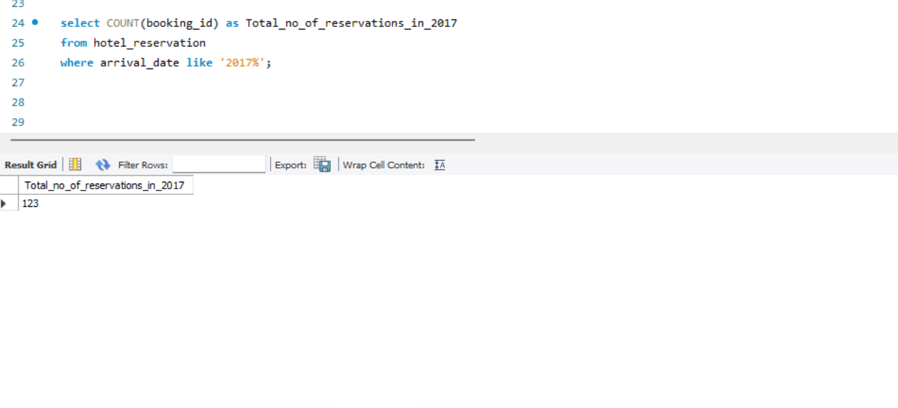
4. How many reservations were made for the year 20XX (replace XX with the desired year)?

Slide 11
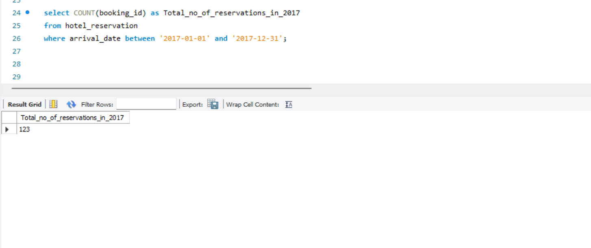

Slide 12
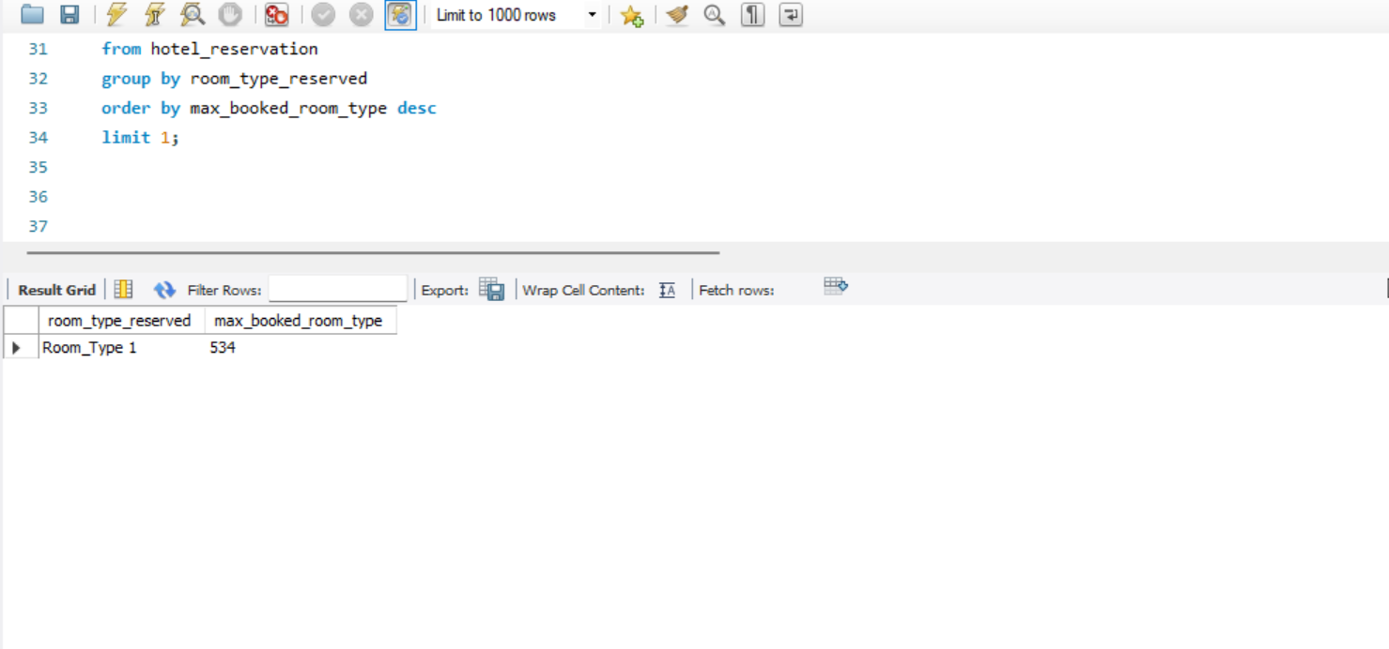
5. What is the most commonly booked room type?

Slide 13
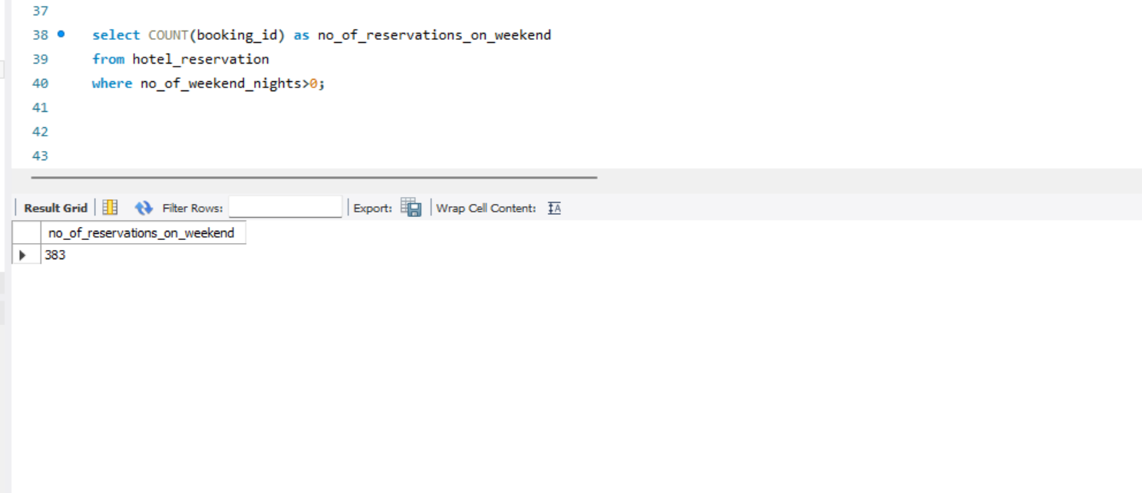
6. How many reservations fall on a weekend (no_of_weekend_nights > 0)?.

Slide 14
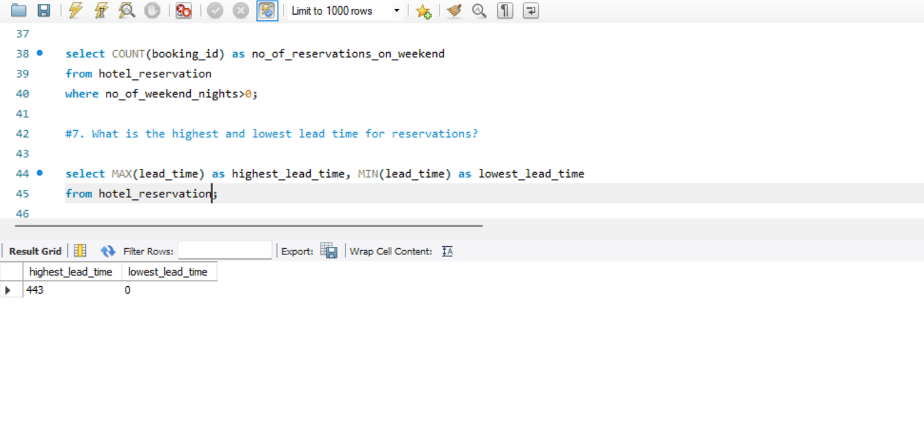
7. What is the highest and lowest lead time for reservations?

Slide 15
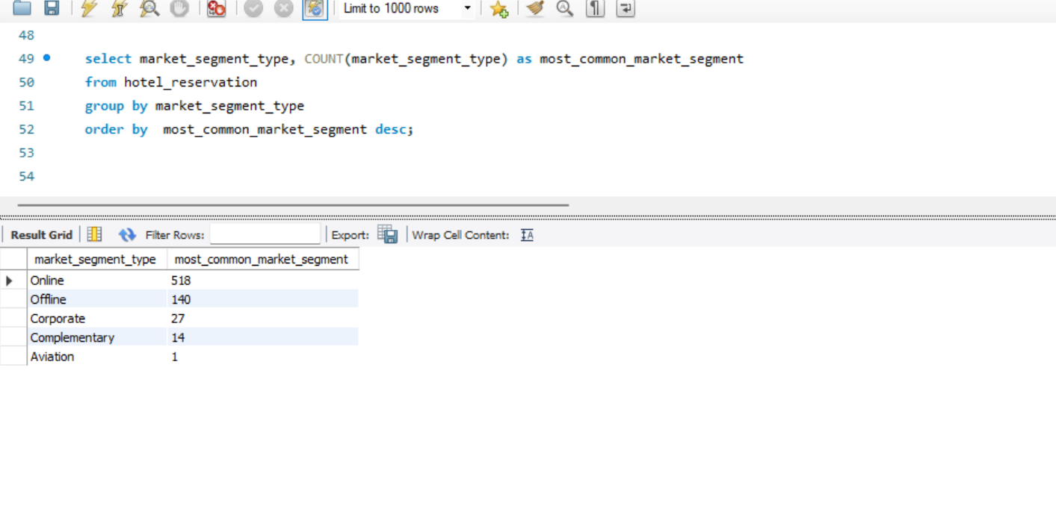
8. What is the most common market segment type for reservations?

Slide 16
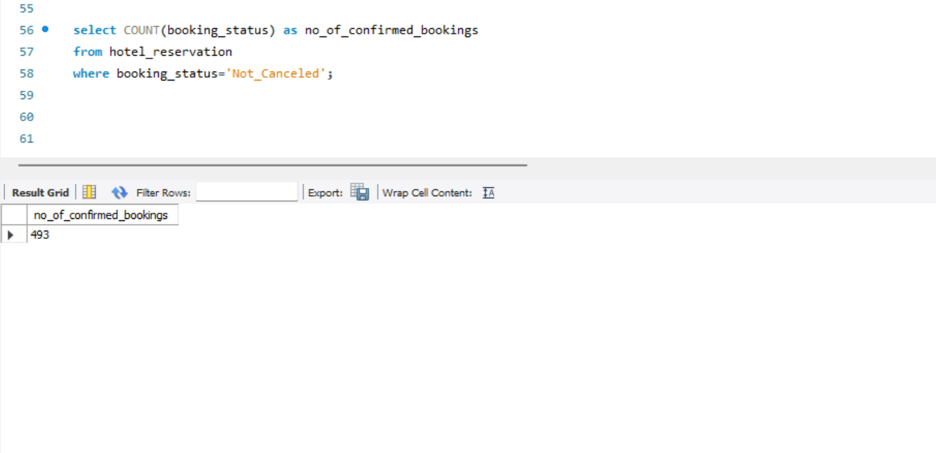
9. How many reservations have a booking status of "Confirmed"?

Slide 17
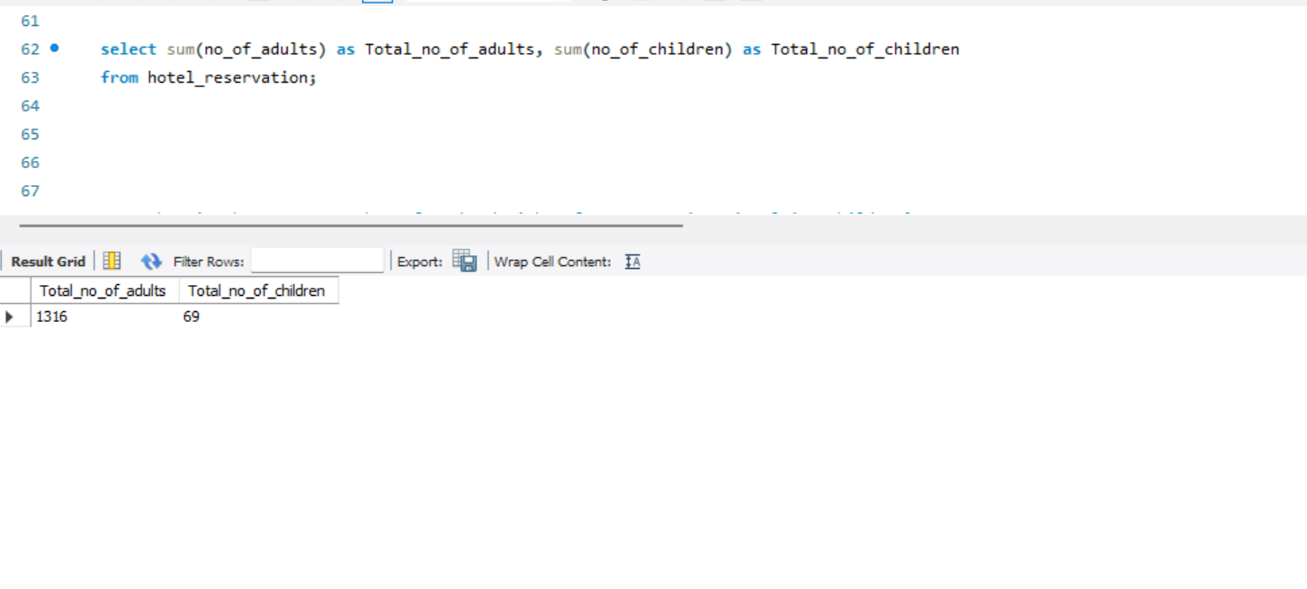
10. What is the total number of adults and children across all reservations?

Slide 18
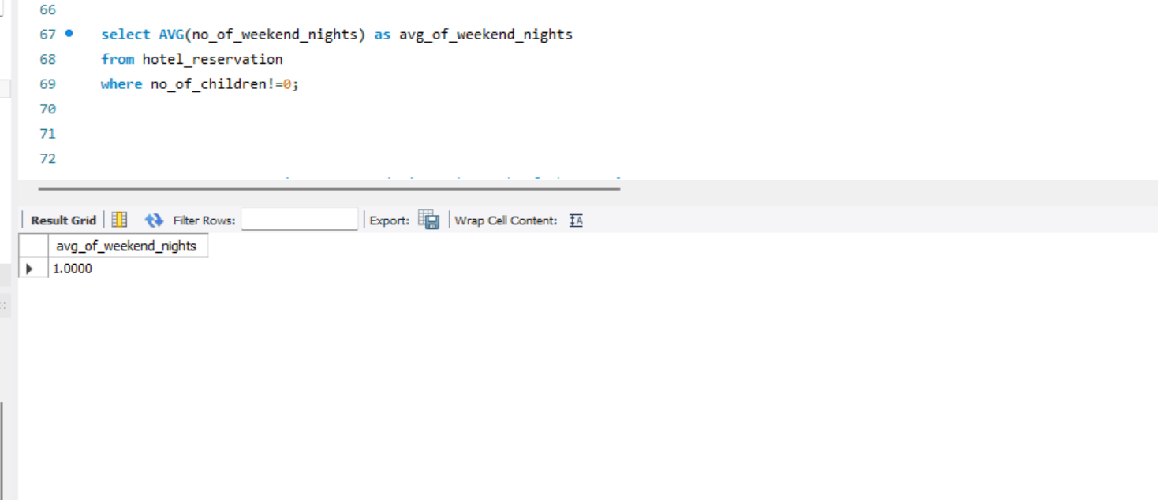
11. What is the average number of weekend nights for reservations involving children?

Slide 19
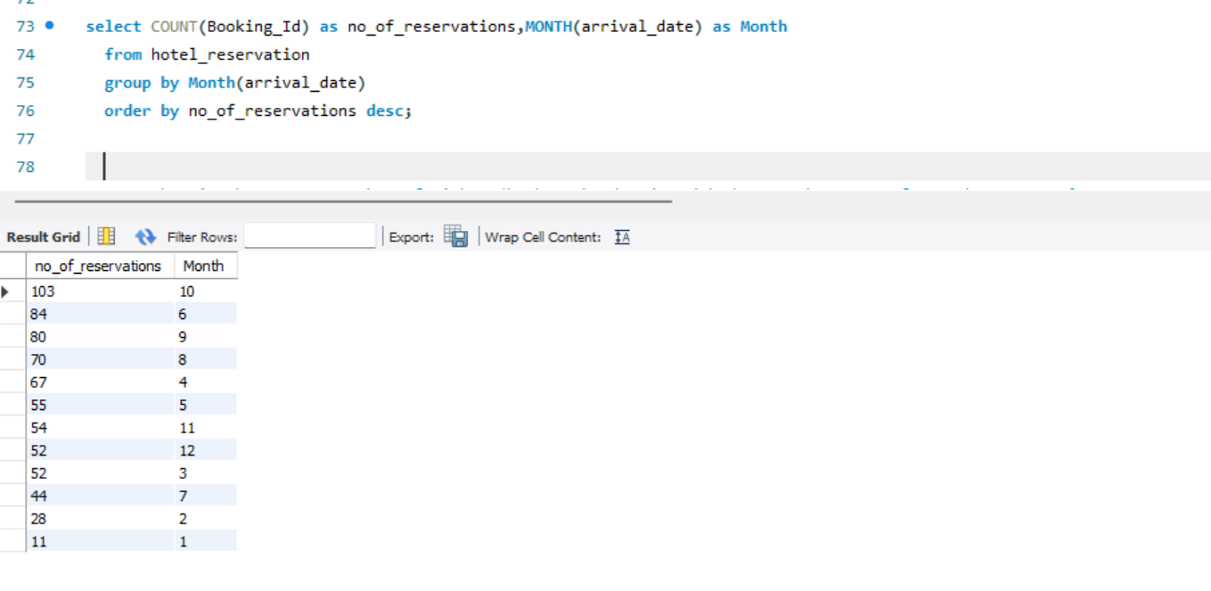
12. How many reservations were made in each month of the year?

Slide 20
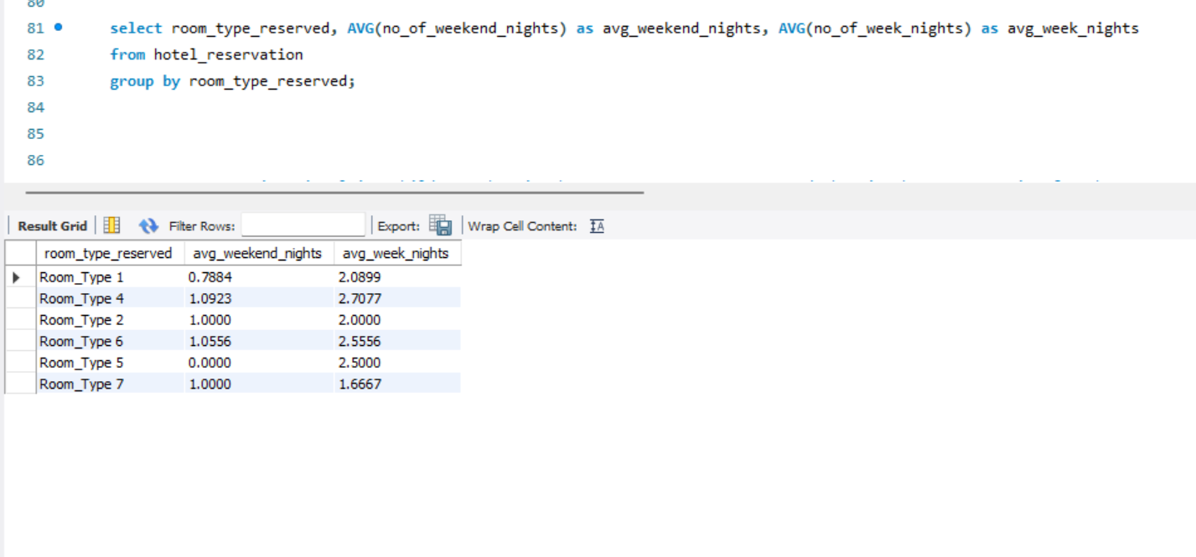
13. What is the average number of nights (both weekend and weekday) spent by guests for each room type?

Slide 21
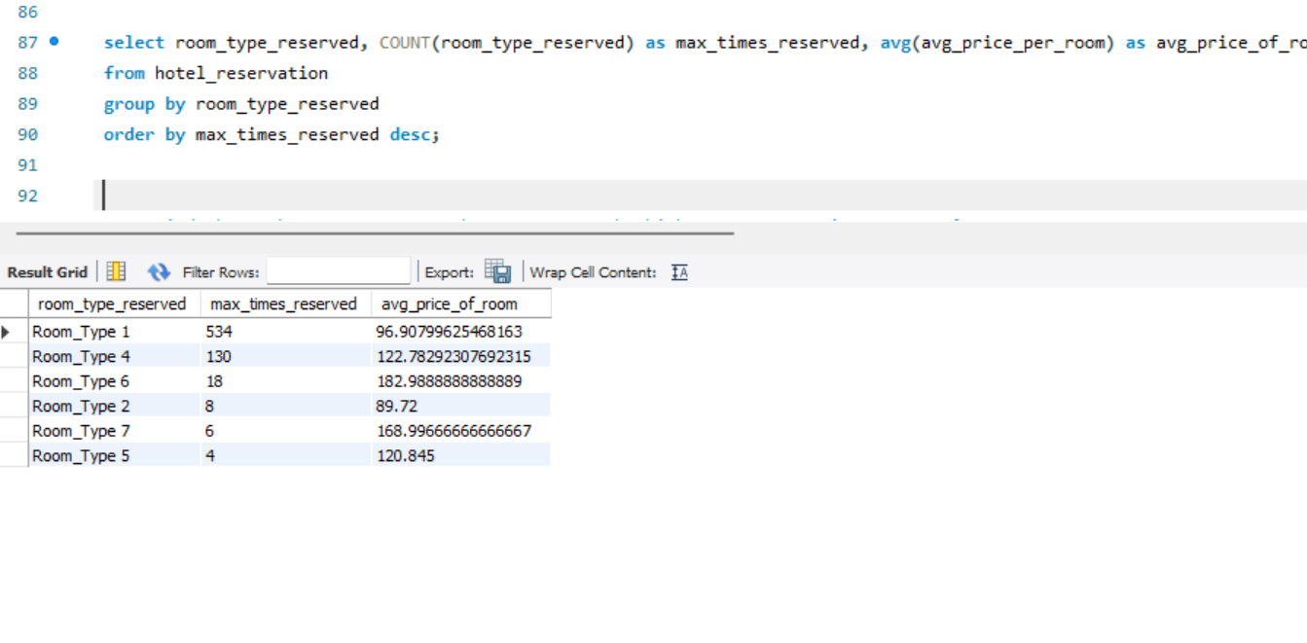
14. For reservations involving children, what is the most common room type, and what is the average price for that room type?

Slide 22
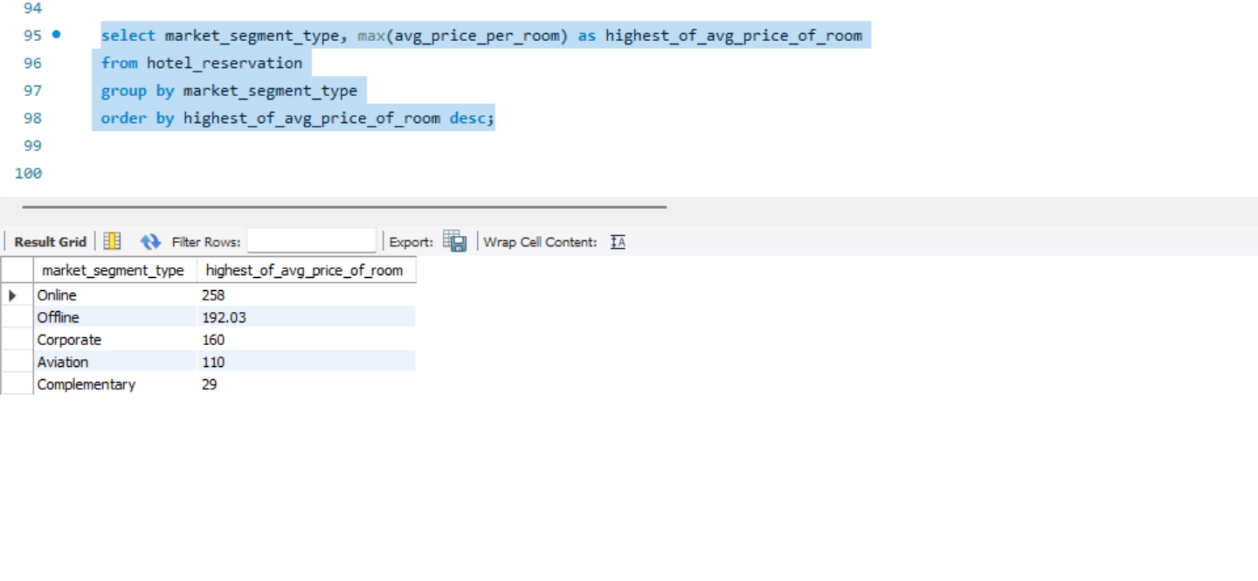
15. Find the market segment type that generates the highest average price per room?

Slide 23
Thank you
Aashritha Kandra
aashrithakandra@gmail.com
Batch Name: MIP-DA-08

